Slide 1
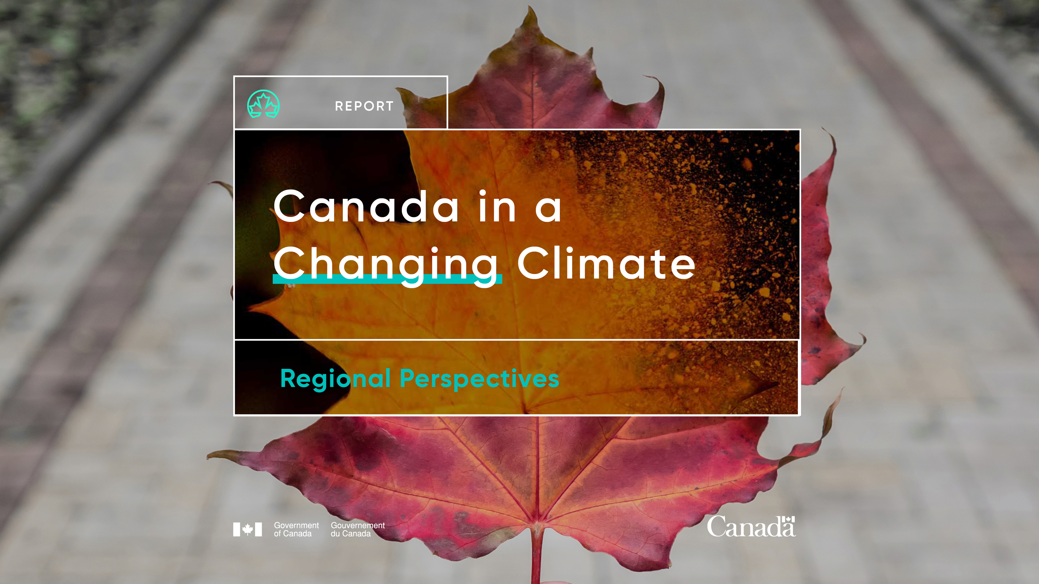
Chapter 6: Northern Canada
Dec. 7, 2022
ArcticNet Annual Scientific Meeting

Slide 2
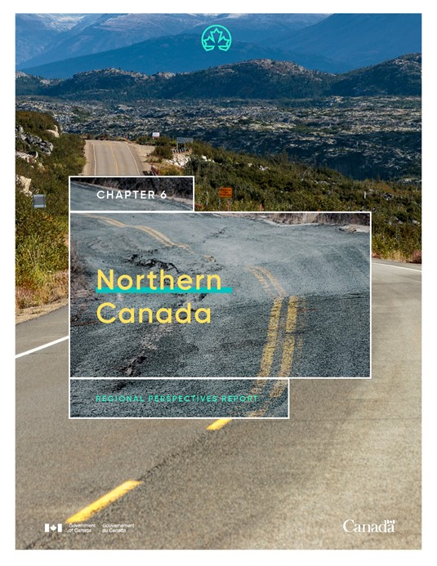
Outline
The National Assessment process and reports
Introduction to the chapter
Key messages
Emerging issues and knowledge gaps
Questions and discussion

Slide 3
Presenters
Coordinating Lead Author:
Bronwyn Hancock, Yukon University (Yukon Resident)
Co-chairs:
Fiona Warren, Natural Resources Canada (Ontario Resident)
Brian Horton, Yukon University (Yukon Resident)
Panelists:
Fanny Amyot, Yukon University (Yukon Resident)
Ashlee Cunsolo, Labrador Campus of Memorial University (Newfoundland and Labrador Resident)
Jackie Dawson, University of Ottawa (Ontario Resident)
Samantha Darling, Carleton University (Yukon Resident)
Pitseolak Pfiefer, Inuit Solutions (Nunavut Resident)

Slide 4
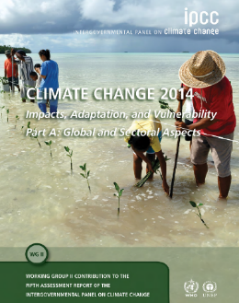
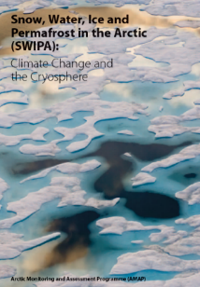
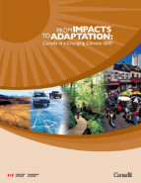
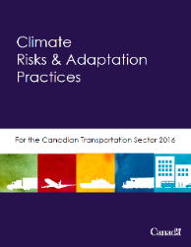
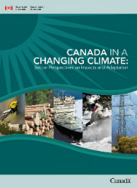
What are assessments?
Credible, useful and decision-relevant products that synthesize existing knowledge on climate change risks, opportunities and adaptation.
Assessment goals:
Raise awareness of issues
Provide a foundation for decision-making
Build capacity on adaptation through the assessment development process
Notes:
Jim to introduce Fiona

Slide 5
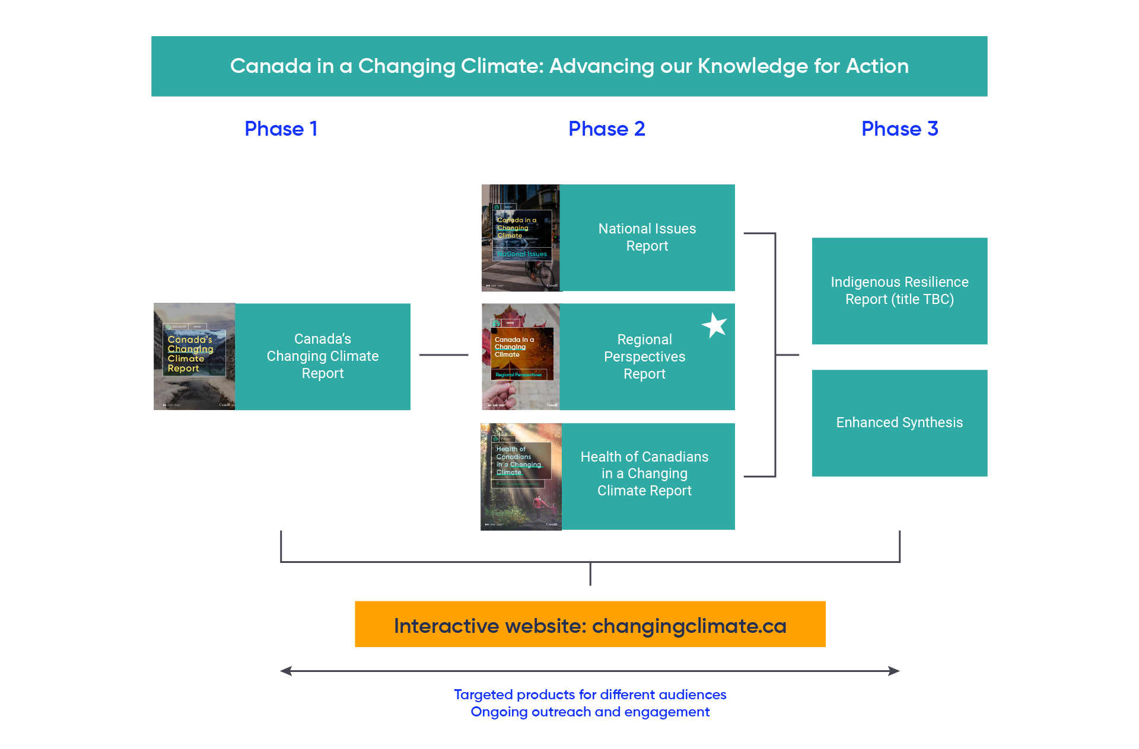
Canada in a Changing Climate Reports

Slide 6
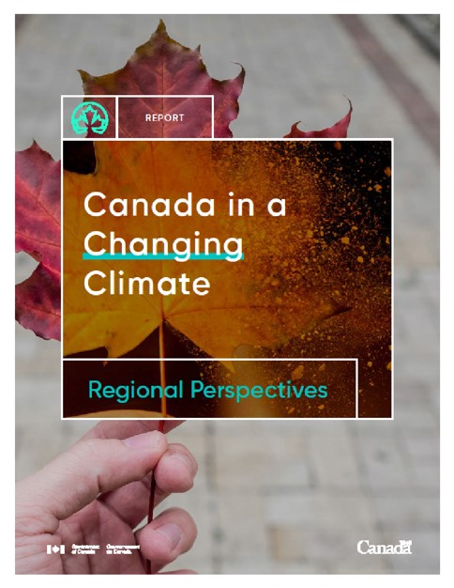
Regional Perspectives Report
Provides regional perspectives of how climate change is affecting our communities, environment and economy, and how we are adapting.
Includes case stories of adaptation in practice.
Chapters from this report are being released on a rolling basis between 2020 and 2022:
Chapter 1 – Atlantic Provinces
Chapter 2 – Quebec
Chapter 3 – Ontario
Chapter 4 – Prairie Provinces
Chapter 5 – British Columbia
Chapter 6 – Northern Canada

Slide 7
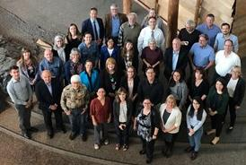
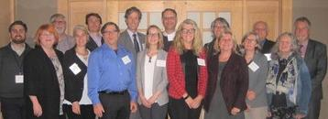
Over 230 experts contributed to the
Regional Perspectives Report
Responsible for delivery of chapters and leading the writing teams
Provide advice, ideas and recommendations to help guide the process
17 Coordinating Lead Authors
20 Advisory Committee Members
100
Contributing Authors
100 Expert Reviewers
Contribute to sections and case stories
Ensure chapters are accurate and relevant
Notes:
The assessment process includes participation from:
All orders of government
Private sector
Professional associations
NGO’s
Academics
Indigenous organizations
Members of the public
100’s more involved in the overall process
~5000 comments received

Slide 8
What’s new in this assessment process?
A suite of products (2019-2022 releases), rather than a single report
Enhanced engagement and communications before, during and after release
Layers of information to address needs of different audiences
e.g., Key message approach, layers of information/tiers, boxes, case stories
Stronger inclusion of multiple sources of knowledge, including Indigenous Knowledge
Explicitly discuss knowledge gaps and emerging issues to establish a baseline
Designed for digital delivery (changingclimate.ca)

Slide 9
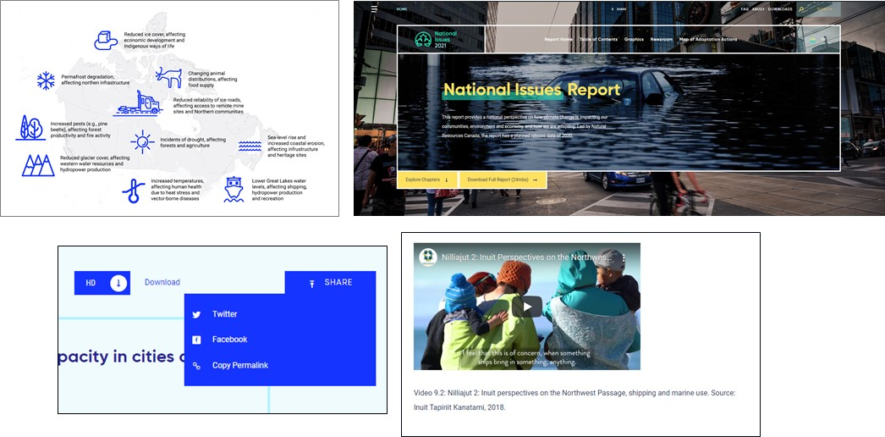
All reports are being delivered digitally
(changingclimate.ca)
Key features include:
Embedded videos
Illustrative photos
Shareable content
Downloadable figures (some interactive)
Hyperlinks between sections and reports
Frequently Asked Questions
Map of case stories
Reports are also available as accessible PDFs on the
NRCan website and at changingclimate.ca

Slide 10
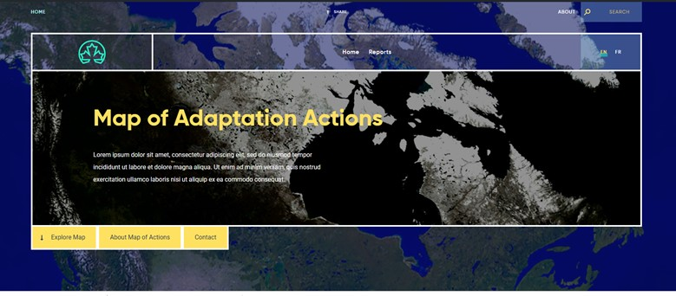
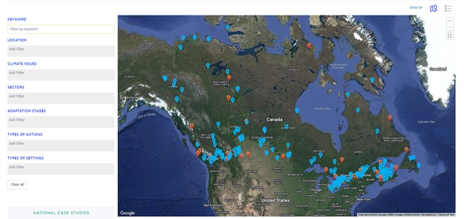
Map of Adaptation Actions provides
examples of adaptation in practice
An interactive, searchable map with examples of adaptation in practice from a range of sources in Canada, including the National Knowledge Assessment:
Targeted to decision-makers and adaptation practitioners
Available at: changingclimate.ca/map
Notes:
28 case stories for Atlantic Canada + x number from the chapter

Slide 11
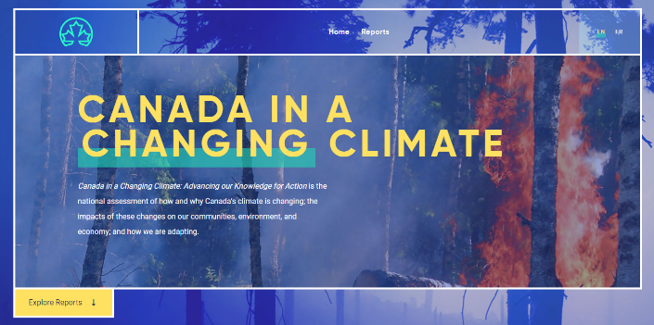

For more information:
Visit changingclimate.ca to access the reports, check out the FAQs and share findings
Visit adaptation.nrcan.gc.ca to learn more about the assessment process
Questions? Send an email to
adaptation@nrcan-rncan.gc.ca
Fiona.Warren@nrcan-rncan.gc.ca

Slide 12
Our approach for the Northern Canada chapter
Key message development and featured case stories were guided by an advisory committee through an iterative, consensus-based approach.
The chapter features mostly northern authors who are diverse in their expertise and lived experience, and who draw on different forms of knowledge in their contributions.
Chapter does not cover all northern climate change adaptation topics; captures what our advisors consider to be high priorities for the North.

Slide 13
Cross-cutting issues form a foundation for efforts to build resilience
Addressing urgent societal issues―such as housing shortages, education, food security and culturally appropriate health and wellness―is deeply intertwined with efforts to build resilience to climate change.
The impacts of colonialism and power differentials in Canada are critical factors in understanding adaptive capacity in the North, and continue to impact adaptive capacity today.
Many locally- and regionally-led projects and initiatives aimed at increasing cultural resilience also support climate change adaptation.

Slide 14
Northern Canada Chapter: Key Messages
Climate change is severely impacting northern landscapes and ecosystems
Health impacts are intensifying and amplifying inequities in the North
Safe travel in the North is threatened by climate change
Northerners are leaders and innovators in climate change adaptation
Recognizing inherent capacity is key to building climate resilience

Slide 15
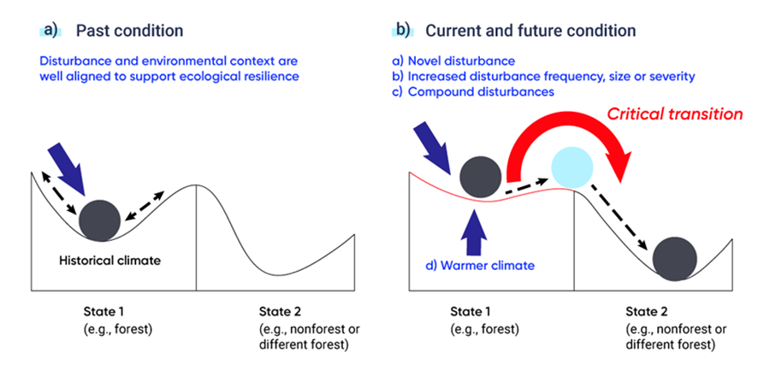
Key Message #1
Climate change is severely impacting northern landscapes and ecosystems
Climate change is producing severe, and in many cases irreversible, changes to northern landscapes and ecosystems.
Northerners are trying to understand the limits of ecosystem resilience and our capacity to adapt to these changes.
Figure 6.6. Adapted from Johnstone et al., 2016.

Slide 16
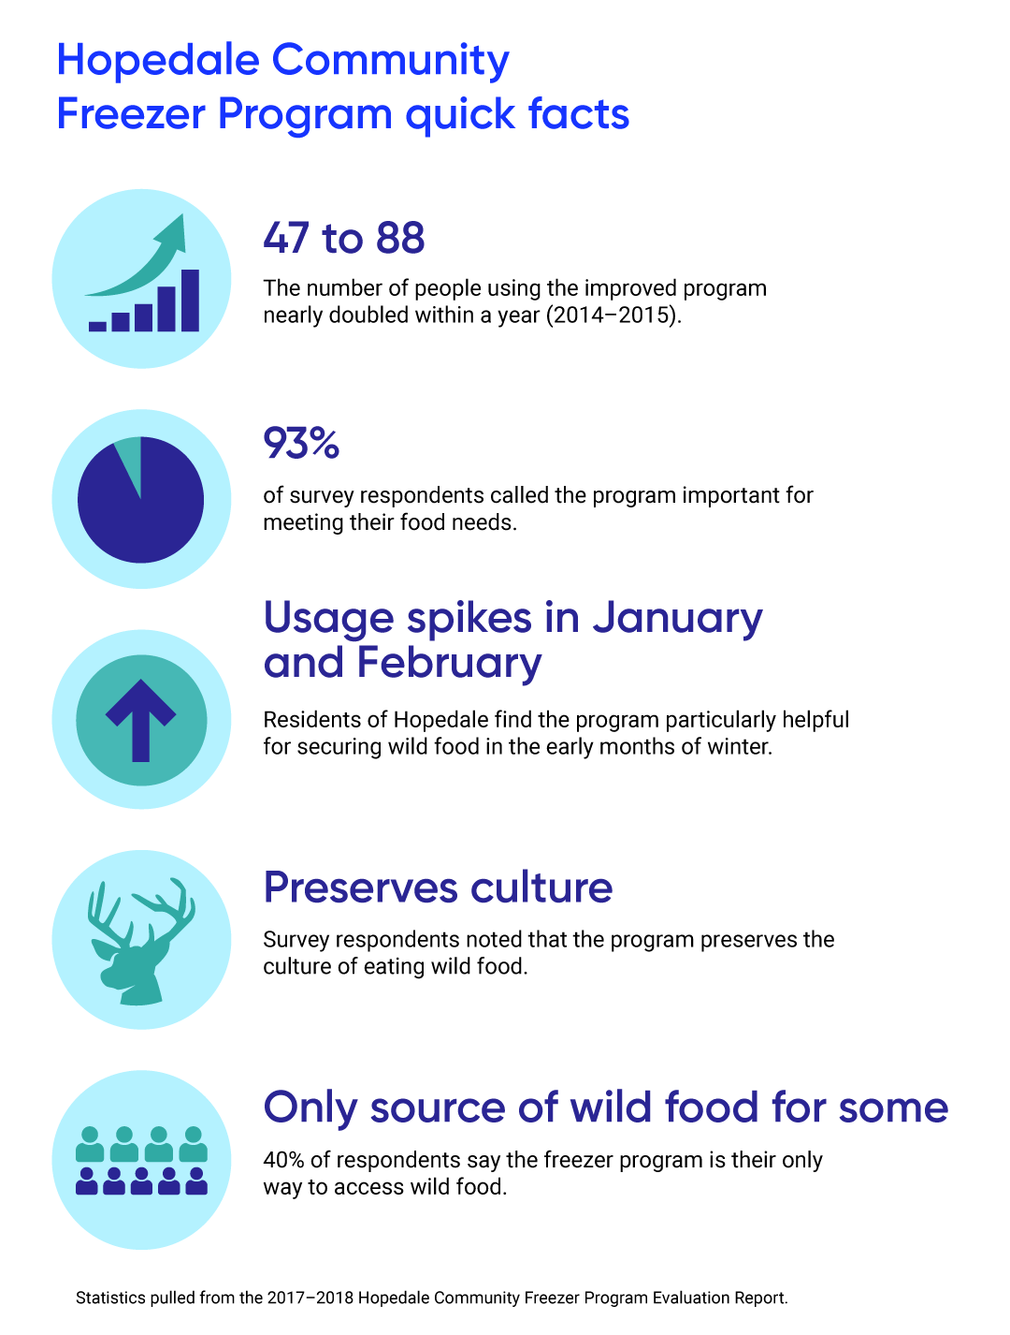
Key Message #2
Health impacts are intensifying and amplifying inequities in the North
Climate change is negatively impacting the health of Northerners, amplifying existing inequities and access to healthcare.
Mental health challenges arise from changing land access, disruptions to cultural activities and knowledge sharing opportunities, shifting place-based identities, and loss of important species, plants, or ecosystems.
Figure 6.8. Adapted from First Food, N.L.

Slide 17
Key Message #2 (continued)
Health impacts are intensifying and amplifying inequities in the North
Locally appropriate, culturally relevant resources and programming, co-created by local communities in partnership with other organizations, are critical to support climate-sensitive physical and mental health outcomes.
Resources and programs must include connection to place and promote increased time on the land to enhance wellness and decrease the strain on limited healthcare resources.

Slide 18
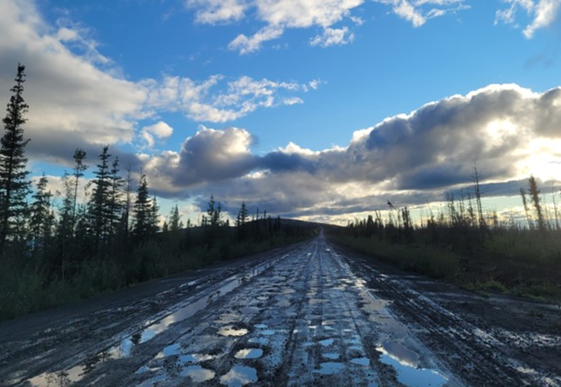
Key Message #3
Safe travel in the North is threatened by climate change
Decreasing ice cover, as well as changing landscapes and weather patterns, are impacting travel in the North.
Northern residents have developed innovative solutions that are specific to the needs in the region.
Combining Indigenous Knowledge, local knowledge and technology can help to reduce challenges and dangers associated with travelling by sea in the face of a changing climate.
Figure 6.10. Photo courtesy of Meredith Caspell, 2022.

Slide 19
Key Message #4
Northerners are leaders and innovators in climate change adaptation
Innovative approaches to governance, policy and development are addressing social inequities and opening pathways for collaborative and inclusive climate change adaptation.
Within the unique governance environment in northern Canada, where many Indigenous communities are self-governing, Indigenous-specific policy spaces are foundational to good governance and are laying the groundwork for innovative approaches to planning and decision making.

Slide 20
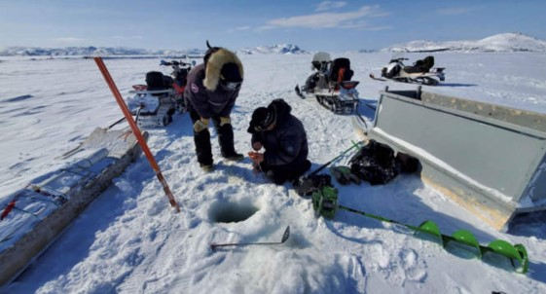
Key Message #5
Recognizing inherent capacity is key to building climate resilience
Organizations and individuals that recognize and embrace the inherent capacity of northern communities to adapt are key players in the pursuit of climate resilience.
Strong connections to the land, social structures that uphold community, and political environments that enable shared decision-making enhance existing resilience.
While innovative research and decision-making partnerships signal a shift in leadership in northern Canada, the existing capacity of Indigenous Northerners based on millennia of observations and adaptation actions too often remains overlooked.
Figure 6.9. Photo courtesy of SmartICE and Hamlin Lampe, 2022.

Slide 21
Emerging issues and knowledge gaps
While the key messages in this chapter are broad in nature, there are several common themes related to gaps in knowledge and emerging issues. These include:
Data availability
Building resilience to multiple stressors
Recognition of health, well-being and societal impacts
Responsive decision making and co-governance
Placing value on Indigenous Knowledge and inherent capacity
Understanding limits to adaptation

Slide 22
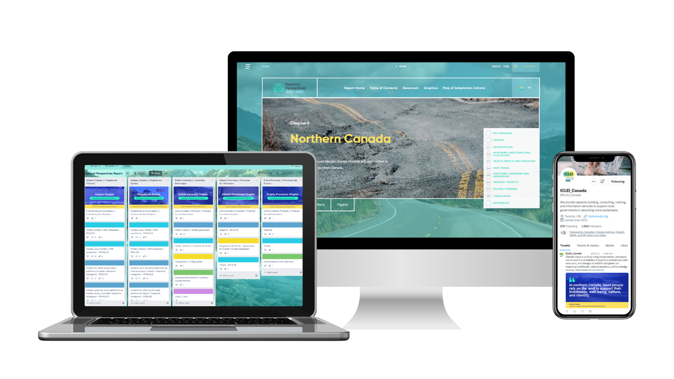

Through the Trello board, you can access ready-made communications products for promoting the chapter on social media and with your networks

